Slide 1
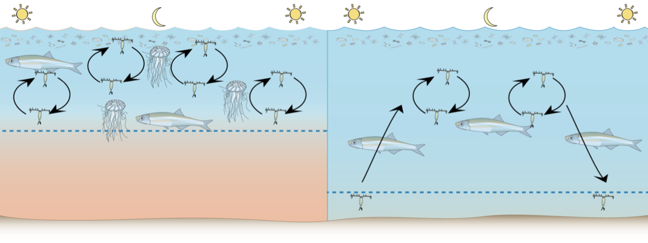
Differentiating the effects of hypoxia on copepods from food web effects in Chesapeake Bay
Jamie Pierson
Michael Roman, Diane Stoecker, Ed Houde, Mary Beth Decker, David Elliott, Ali Barba, Katherine Liu

Slide 2
Why is there a blue hole of zooplankton in the middle of Chesapeake Bay? Hypoxia?
Predation?
Fish, Jellies
Food limitation?
Phyto- and microzoo- plankton
Hypoxia?
Direct effect: mortality
Indirect effects: trophic interaction or physiological stress
Adapted from Roman et al 2005

Slide 3
To understand hypoxia’s effects we need to account for other factors
Prey field
Quality
Quantity
Predation
Gelatinous zooplankton
Fish
Non-consumptive mortality
Advection
Adapted from Roman et al 2005

Slide 4
Our goals are to …
… develop a mechanistic understanding of how the behavior and fitness of copepods is influenced by hypoxia in the field.
… understand how these effects are expressed in population abundance, distribution and trophic dynamics in the field.

Slide 5
Low-oxygen bottom waters…
…exercise control over the vertical distribution and migration behavior of copepods.
…reduce the fitness of copepods.
…increase mortality rate by directly killing copepods and their eggs.

Slide 6
Zooplankton vertical migration is truncated in hypoxic conditions

Slide 7
Survival and egg hatching success is affected by low DO
Roman et al 1993

Slide 8
Hypoxia slows the development of copepod eggs, but does not kill them
Marsha-Gail Davis, unpublished
Notes:
Many eggs in LB stage but no hatched nauplii
Chi-squared detected significance for 0.5, 1.0 and 1.5 (P < 0.001)
No significance for 2.0 = An arbitrary value

Slide 9
Development time is depressed by hypoxia, and is sex specific
D Elliott, unpublished

Slide 10
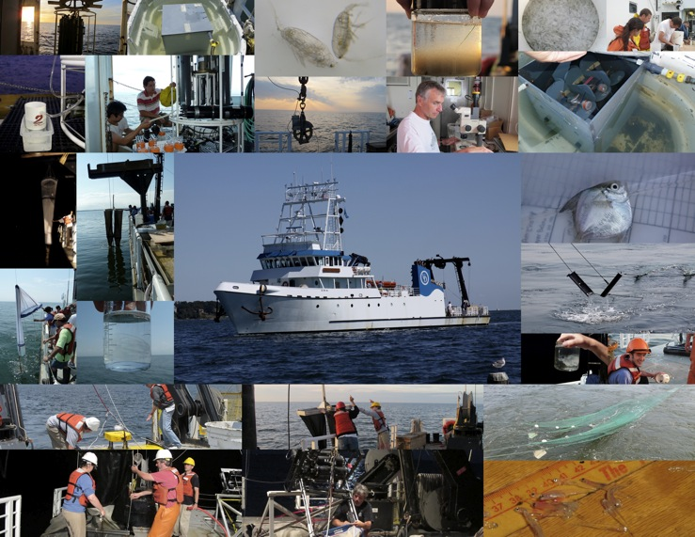
How do these lab findings translate to the field?

Slide 11
Preliminary hydrographic results show the development of hypoxia in late May.

Slide 12
Preliminary hydrographic results show well developed hypoxia in August.

Slide 13
Preliminary hydrographic results show hypoxia breaking up in late September.

Slide 14
Biomass and microplankton composition differed in May 2010
Normoxic
Hypoxic

Slide 15
Microplankton communities were similar in August 2010
Normoxic
Hypoxic

Slide 16
Similarities in microplankton communities remained in September
Normoxic
Hypoxic

Slide 17
OPC data show patchy size-specific zooplankton distribution and zooplankton presence in hypoxia

Slide 18
Acartia tonsa female abundance is centered on the oxycline, with some in the hypoxic zone

Slide 19
To be continued
3 cruises in 2011
Fish and Gelatinous Zooplankton gut contents
Egg and post-embryonic mortality
Curricular materials based on our findings
COSEE Coastal Trends, Laura Murray and Deidre Gibson
Comparison with other hypoxic systems

Slide 20
IBM models can help us understand controls on populations
D Elliott, unpublished

